Slide 1

Chapter 1
Introduction

Slide 2
Chapter 1
Objectives
To define three security goals
To define security attacks that threaten security goals
To define security services and how they are related to the three security goals
To define security mechanisms to provide security services
To introduce two techniques, cryptography and
steganography, to implement security mechanisms.

Slide 3
Definitions
Computer Security - generic name for the collection of tools designed to protect data and to thwart hackers
Network Security - measures to protect data during their transmission
Internet Security - measures to protect data during their transmission over a collection of interconnected networks

Slide 4
1-1 SECURITY GOALS
This section defines three security goals.
Topics discussed in this section:
    Confidentiality
    Integrity
    Availability

Slide 5


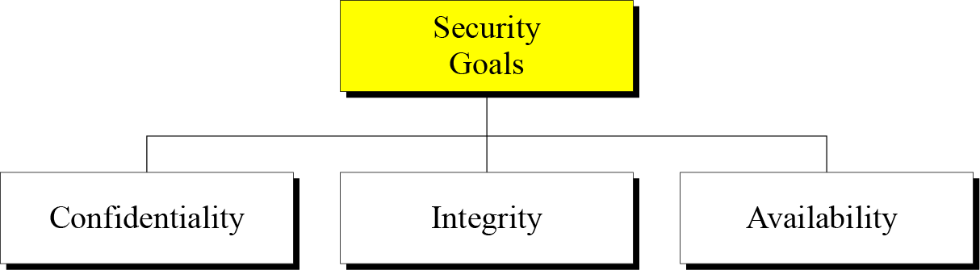
1.1 Continued
Figure 1.1 Taxonomy of security goals

Slide 6
1.1.1 Confidentiality
Confidentiality is probably the most common aspect of information security. We need to protect our confidential information. An organization needs to guard against those malicious actions that endanger the confidentiality of its information.

Slide 7
1.1.2 Integrity
Information needs to be changed constantly. Integrity means that changes need to be done only by authorized entities and through authorized mechanisms.

Slide 8
1.1.3 Availability
The information created and stored by an organization needs to be available to authorized entities. Information needs to be constantly changed, which means it must be accessible to authorized entities.

Slide 9
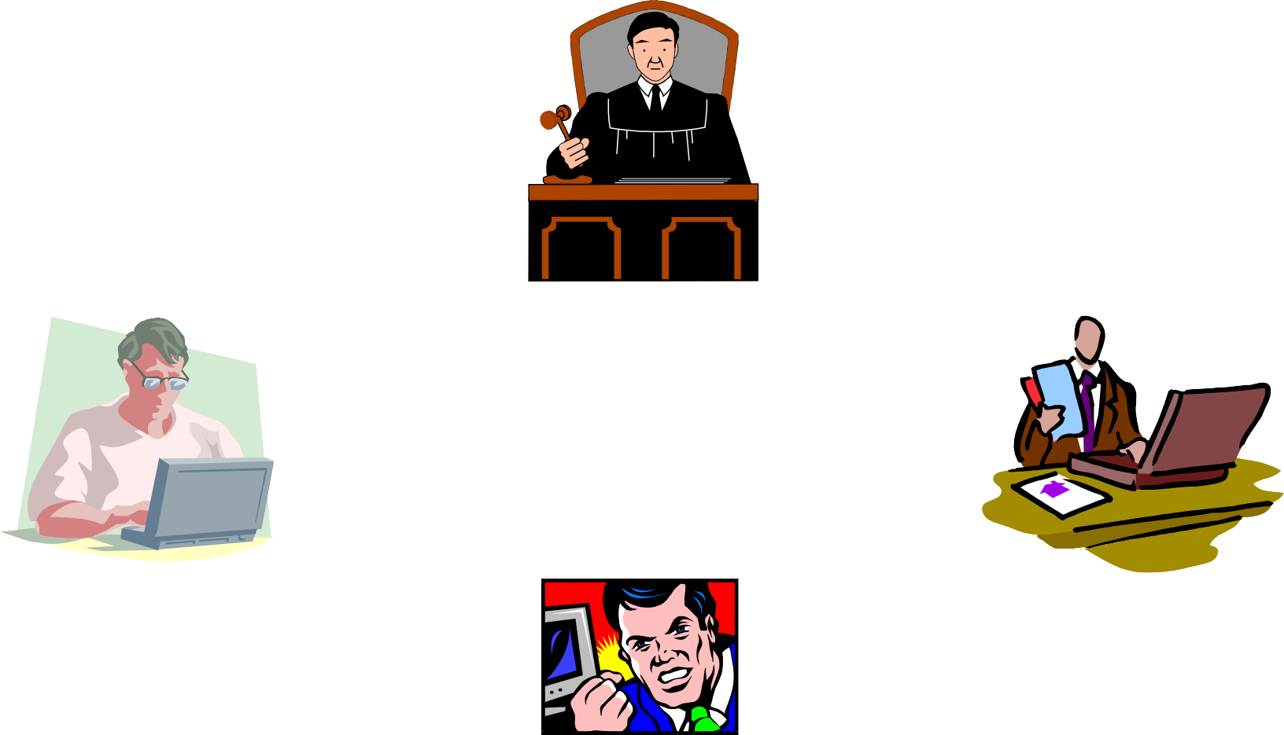
Network Security Model
Trusted Third Party
principal
principal
Security transformation
Security
transformation
attacker

Slide 10
1-2 ATTACKS
The three goals of security⎯confidentiality, integrity, and availability⎯can be threatened by security attacks.
Topics discussed in this section:
    Attacks Threatening Confidentiality
    Attacks Threatening Integrity
    Attacks Threatening Availability
    Passive versus Active Attacks

Slide 11
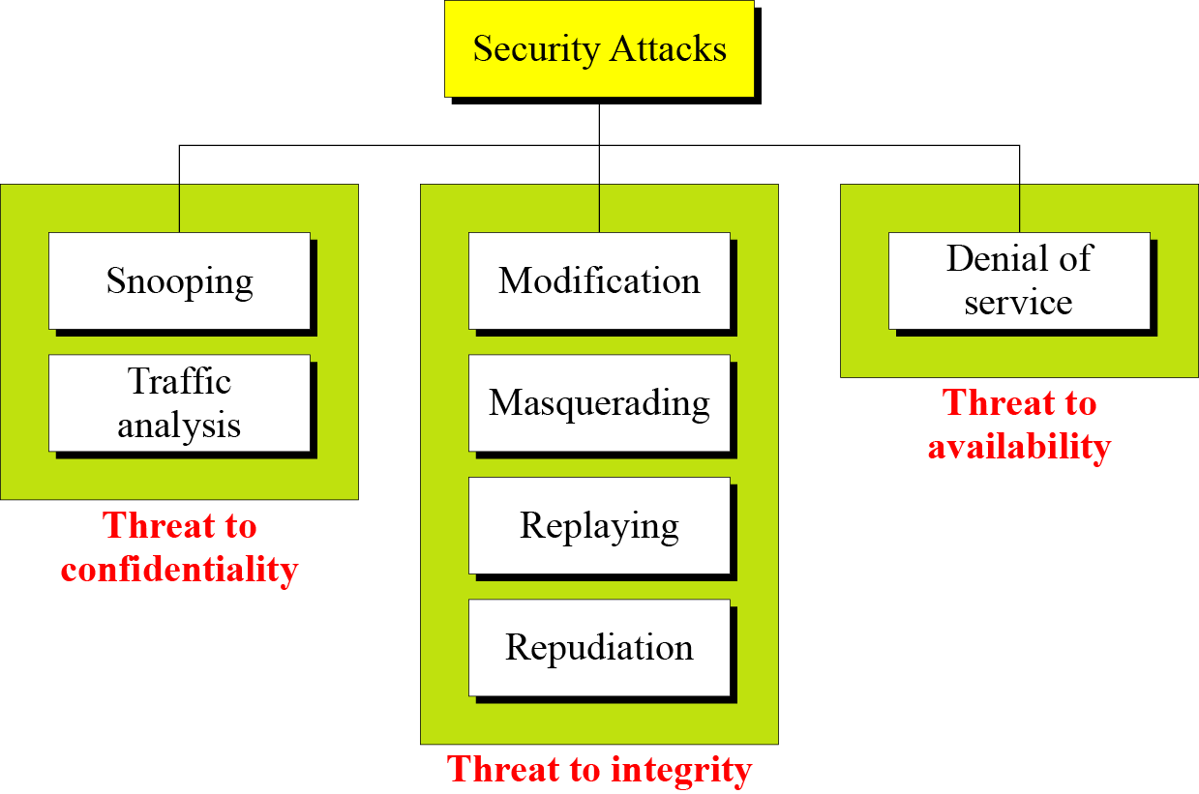
1.2 Continued
Figure 1.2 Taxonomy of attacks with relation to security goals

Slide 12
1.2.1 Attacks Threatening Confidentiality
Snooping refers to unauthorized access to or interception of data.
Traffic analysis refers to obtaining some other type of information by monitoring online traffic.

Slide 13

Information Transferring

Slide 14


Attack: Interruption
Cut wire lines, Jam wireless signals,
Drop packets,

Slide 15
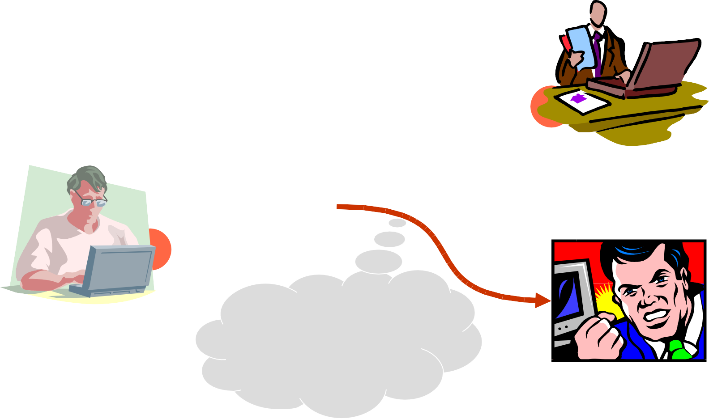
Attack: Interception
Wiring, eavesdrop

Slide 16
1.2.2 Attacks Threatening Integrity
Modification means that the attacker intercepts the message and changes it.
Masquerading or spoofing happens when the attacker impersonates somebody else.
Replaying means the attacker obtains a copy of a message sent by a user and later tries to replay it.
Repudiation means that sender of the message might later deny that she has sent the message; the receiver of the message might later deny that he has received the message.

Slide 17
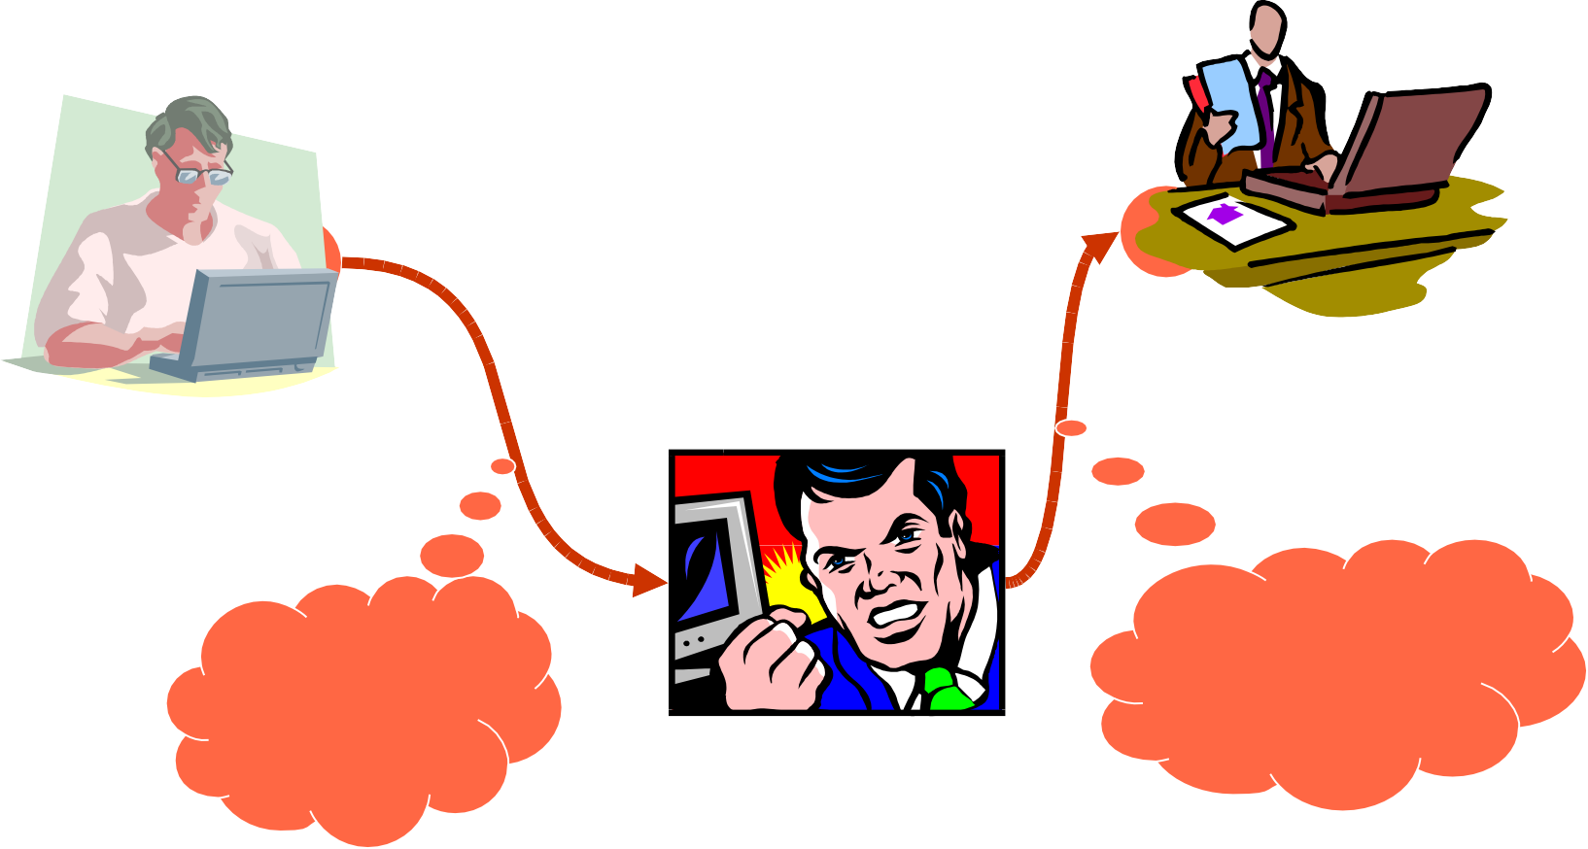
Attack: Modification
Replaced info
intercept

Slide 18
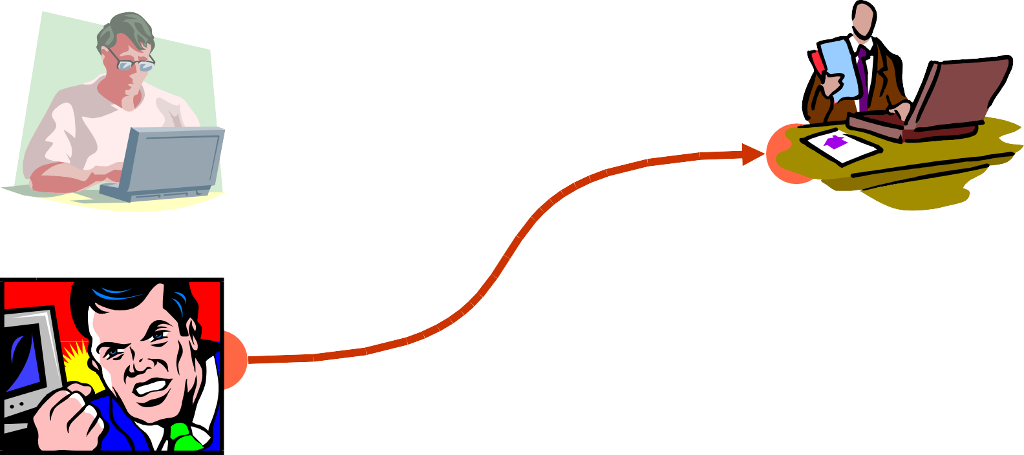
Attack: Fabrication
Also called impersonation

Slide 19
1.2.3 Attacks Threatening Availability
Denial of service (DoS) is a very common attack. It may slow down or totally interrupt the service of a system.

Slide 20
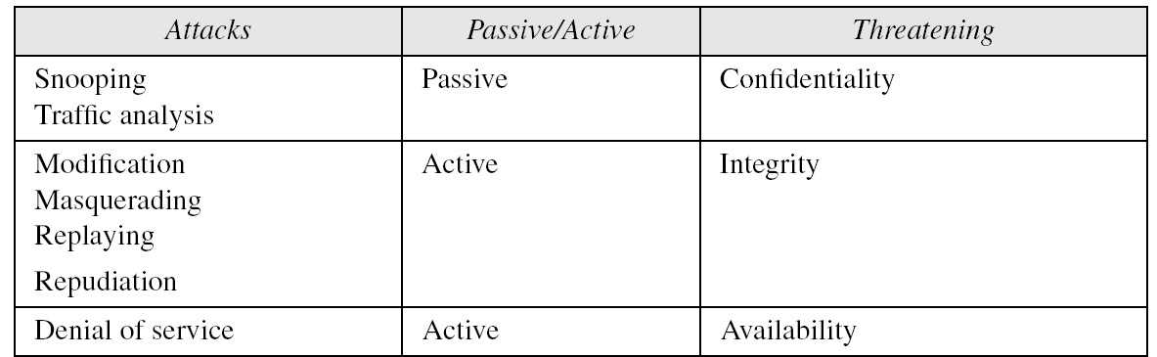
1.2.4 Passive Versus Active Attacks
Table 1.1 Categorization of passive and active attacks

Slide 21
1-3 SERVICES AND MECHANISMS
ITU-T provides some security services and some mechanisms to implement those services. Security services and mechanisms are closely related because a mechanism or combination of mechanisms are used to provide a service..
Topics discussed in this section:
    Security Services
    Security Mechanism
    Relation between Services and Mechanisms

Slide 22
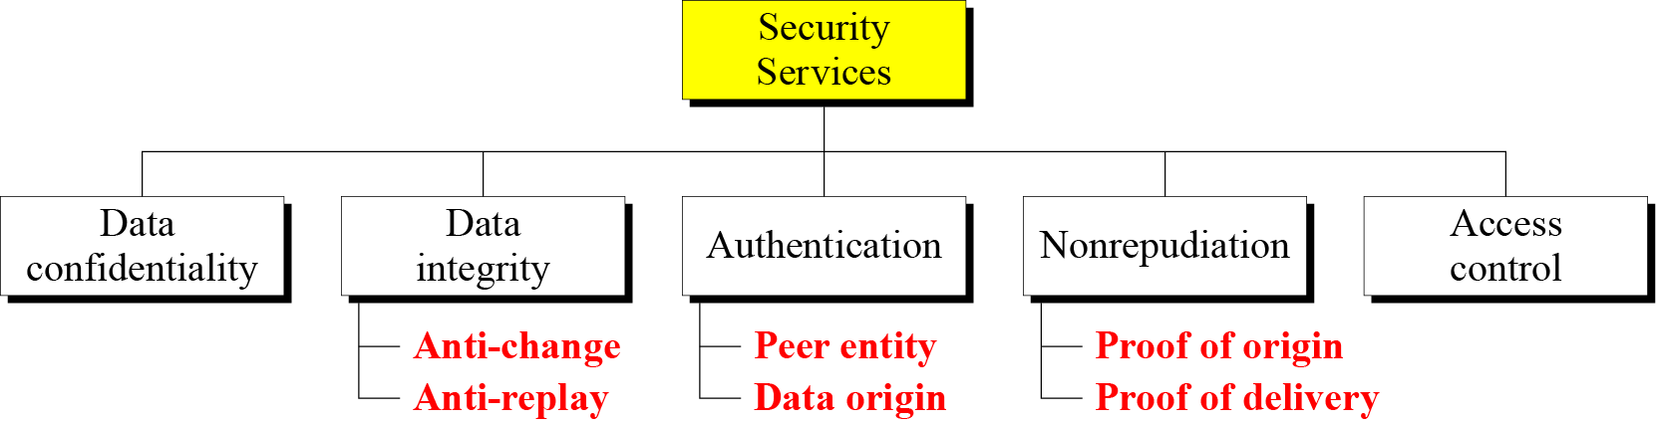
1.3.1 Security Services
Figure 1.3 Security services
5 Confidentiality

Slide 23
Security Services (X.800)
Authentication-
--- Peer Entity authentication.
--- Data Origin authentication.
Data Confidentiality-
---Connection Confidentiality.
---Connectionless confidentiality.
---Selected Field confidentiality.
---Traffic Flow Confidentiality.

Slide 24
Security Services (X.800)
Data Integrity.
-Connection integrity with recovery.
  Connection integrity without recovery.
  Connectionless integrity.
-Selected field connection Integrity.
  Selected field connectionless Integrity.

Slide 25
Security Services (X.800)
Nonrepuditation
-nonrepuditation Origin.
- nonrepuditation destination.
Access Control

Slide 26
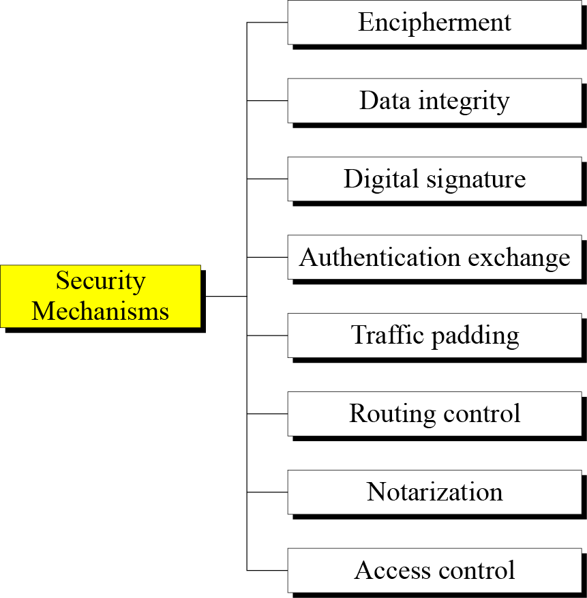
1.3.2 Security Mechanism
Figure 1.4 Security mechanisms

Slide 27
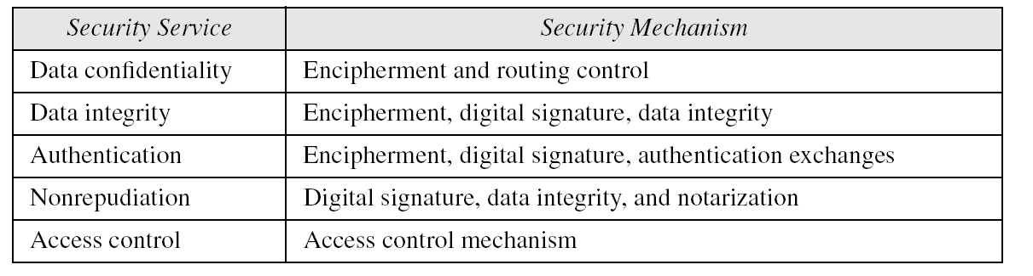
1.3.3 Relation between Services and Mechanisms
Table 1.2 Relation between security services and mechanisms

Slide 28
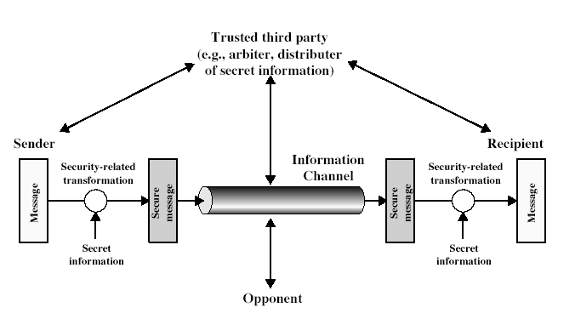
Model for Network Security

Slide 29
Model for Network Security
using this model requires us to:
  design a suitable algorithm for the security transformation
  generate the secret information (keys) used by the algorithm
  develop methods to distribute and share the secret information
  specify a protocol enabling the principals to use the transformation and secret information for a security service

Slide 30
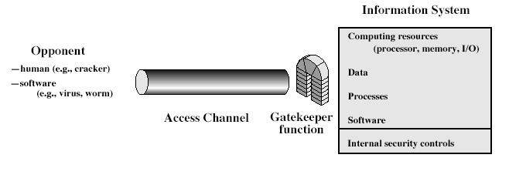
Model for Network Access Security

Slide 31
Model for Network Access Security
using this model requires us to:
  select appropriate gatekeeper functions to identify users
  implement security controls to ensure only authorised users access designated information or resources
trusted computer systems can be used to implement this model

Slide 32
1-4 TECHNIQUES
Mechanisms discussed in the previous sections are only theoretical recipes to implement security. The actual
implementation of security goals needs
some techniques. Two techniques are prevalent today:
cryptography and steganography.
Topics discussed in this section:
    Cryptography
    Steganography

Slide 33
1.4.1 Cryptography
Cryptography, a word with Greek origins, means “secret writing.” However, we use the term to refer to the science and art of transforming messages to make them secure and immune to attacks.

Slide 34
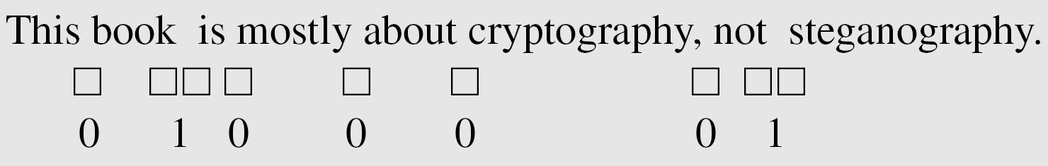
1.4.2 Steganography
The word steganography, with origin in Greek, means “covered writing,” in contrast with cryptography, which means “secret writing.”
Example: covering data with text

Slide 35
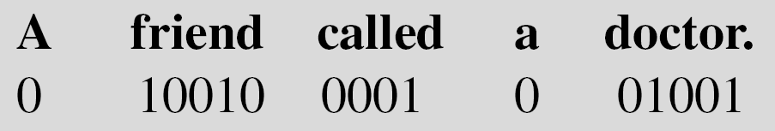
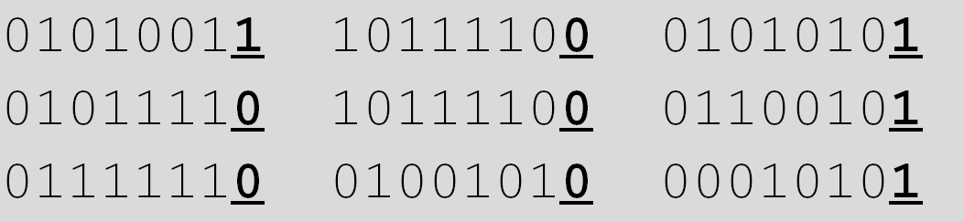
1.4.2 Continued
Example: using dictionary
Example: covering data under color image

